Slide 1

Intelligent AQI Monitoring – POC
Building a robust AQI classification Proof of Concept
Team: [Ashish ,Dhirendra] • Date: Nov 27, 2025

Slide 2

Outline & Background
The Challenge:
Our Solution:
Need for real-time, accurate AQI monitoring
Data-driven AQI classification
Health, policy, and alert implications
Predictive alerts
Robust POC development
Key Data: Sensor readings (PM2.5, PM10, NO2, SO2, CO, Ozone, AQI value)

Slide 3

Caveats & Limitations
Dataset Constraints
Size and coverage may limit generalizability.
Sensor Reliability
Calibration errors and temporal gaps are possible.
Regional Variation
Pollutant behavior affects model portability.
Maintenance Needs
Real-time deployment requires continuous sensor upkeep.
Acknowledging these helps us plan for future mitigation strategies.

Slide 4


Data & Processing: EDA + Cleaning
Initial Steps
Feature Engineering
Loaded: AQI_DS.csv
Outlier capping with IQR
Columns: Date, Month, Year, Pollutants (PM2.5, PM10, NO2, SO2, CO, Ozone), AQI
Created PM_ratio feature
Dropped duplicates
Engineered Pollutant_Load and Toxicity_Index
Median imputation for missing values
Converted AQI numeric to 3-class categorical labels: Good / Moderate / Hazardous

Slide 5
Exploratory Data Analysis (Key Plots)
AQI Category Distribution
Correlation Heatmap
Pollutant Boxplots
Monthly AQI Trend
Identifying relationships between numeric features and AQI.
Understanding pollutant distributions and identifying outliers.
Observing seasonal patterns and long-term changes in AQI.
Visualizing the frequency of Good, Moderate, and Hazardous days.

Slide 6


Innovative Feature: Weighted Toxicity Index
Toxicity_Index = 0.3 * NO2 + 0.3 * SO2 + 0.4 * CO
This novel feature specifically targets the differential impact of pollutants, leading to more nuanced and accurate risk assessment.
Weights reflect acute health impact (EPA/WHO guidelines)
Improves discrimination for 'Hazardous' classification
Used with PM_ratio and Pollutant_Load for enhanced accuracy

Slide 7
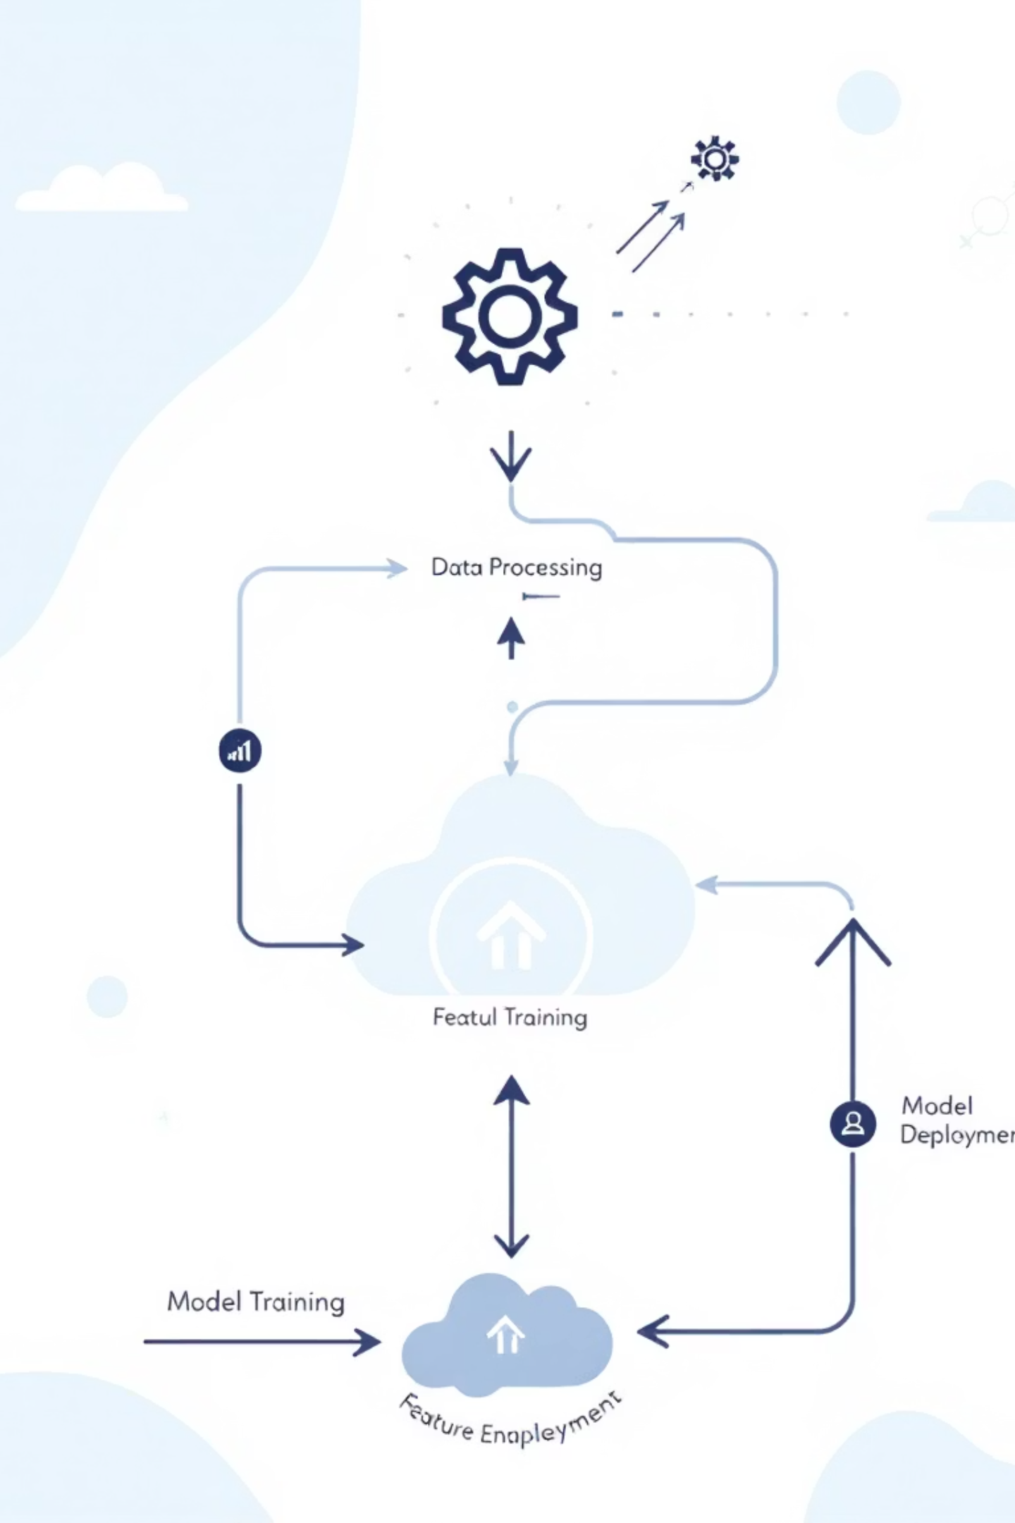
Models & Training Overview
Model Selection
1
Random Forest (robustness), SVM (boundary separation), Logistic Regression (interpretability)
Preprocessing
2
Class balancing (SMOTE) and scaling (StandardScaler)
Data Split
3
Stratified 80% train / 20% test split
Hyperparameter Tuning
4
Optimized for performance and overfitting prevention

Slide 8

Statistical Outcomes: Key Metrics
95%
94%
91%
Random Forest
SVM (RBF)
Logistic Regression
Accuracy (Test)
Accuracy (Test)
Accuracy (Test)
Precision / Recall / F1-score
Confusion Matrices
Detailed per-class metrics provided in the full report.
Strong detection of 'Hazardous' events across models.
ROC-AUC
All models achieve >0.90 for main classes.

Slide 9
Sample Predictions
Demonstrating model confidence and real-time alerting potential.
Pollutant Mix
PM2.5
AQI Value
Predicted Class
Probability (Hazardous)
Mix A
15
45
Good
0.02
Mix B
40
80
Moderate
0.15
Mix C
120
180
Hazardous
0.96
Mix D
70
110
Unhealthy
0.60
Mix E
25
60
Moderate
0.08

Slide 10




Conclusion & Next Steps
Robust POC Achieved
Demonstrated >90% accuracy in AQI classification.
Real-time Integration
Next: Streaming ingestion, edge deployment, alert systems.
Enhanced Forecasts
Future data: Incorporate weather, traffic, and satellite inputs.
Our project lays the groundwork for proactive public health management and early warning systems against air pollution.

Slide 11
REFERENCES
US EPA: Technical Assistance Document for AQI
World Health Organization (WHO) Air Quality Guidelines, 2021
Research papers on AQI prediction and ML air quality modelling
Dataset provider acknowledgements

